Slide 1
Bayesian Inference in Games of Probability
Daniel Albright

Slide 2

Research Problem
How well are humans able to update their probabilities where they run counter to their beliefs?
…How about ambiguous circumstances?
Bayes rule

Slide 3
Bayes’ theorem was the subject of a detailed article. The essay is good, but over 15,000 words long — here’s the condensed version for Bayesian newcomers like myself:
Tests are not the event. We have a cancer test, separate from the event of actually having cancer. We have a test for spam, separate from the event of actually having a spam message.
Tests are flawed. Tests detect things that don’t exist (false positive), and miss things that do exist (false negative).
Tests give us test probabilities, not the real probabilities. People often consider the test results directly, without considering the errors in the tests.
False positives skew results. Suppose you are searching for something really rare (1 in a million). Even with a good test, it’s likely that a positive result is really a false positive on somebody in the 999,999.
People prefer natural numbers. Saying “100 in 10,000″ rather than “1%” helps people work through the numbers with fewer errors, especially with multiple percentages (“Of those 100, 80 will test positive” rather than “80% of the 1% will test positive”).
Even science is a test. At a philosophical level, scientific experiments can be considered “potentially flawed tests” and need to be treated accordingly. There is a test for a chemical, or a phenomenon, and there is the event of the phenomenon itself. Our tests and measuring equipment have some inherent rate of error.
Bayes’ theorem gives you the actual probability of an event given the measured test probabilities. For example, you can:
Correct for measurement errors. If you know the real probabilities and the chance of a false positive and false negative, you can correct for measurement errors.
Relate the actual probability to the measured test probability. Bayes’ theorem lets you relate Pr(A|X), the chance that an event A happened given the indicator X, and Pr(X|A), the chance the indicator X happened given that event A occurred. Given mammogram test results and known error rates, you can predict the actual chance of having cancer.

Slide 4
Lit Review
When Optimal Choices Feel Wrong: A Laboratory Study of Bayesian Updating, Complexity, and Affect (Charness Levin 2004)
Theory of Decision Under Uncertainty (Gilboa 2009)
Decision Theory Under Ambiguity (Etner Jeleva Tallon 2012)
Bayesian Updating with Confounded Signals (Farzinnia McArdle 2010)

Slide 5
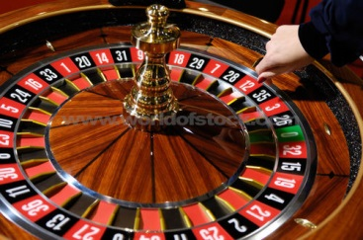
Control: Independence
Board Showing:
3 Red
35 Black
20 Red
17 Red
31 Black
20 Red
21 Red
19 Red
9 Red
25 Black
Observance of Independence of Trials through Roulette
Regulation Roulette Table
7 Reds, 3 Blacks
How do you bet?
WHY did you bet that way?
Red is hot! (How can I lose?!)
Black is not! (Bound to come up soon, right?)
I chose randomly (I R smart!)
I don’t know! or I don’t care! (Still Independent!)

Slide 6
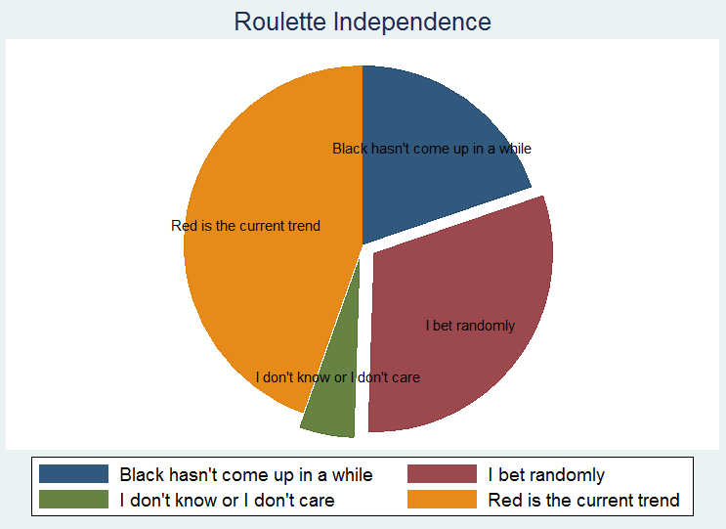
Control: Independence

Slide 7
Control: Probability Weighting Function
Eliciting subject’s pwf through a lottery
50% of winning $100
What’s the most you are willing to pay for this ticket?
i.e. Someone is bidding against you for it.
Only trying to establish a base, not solve for γ
EV = $100 × П(p) + $0 × П(p)
So risk neutral, П(p) = .50 = 50%

Slide 8
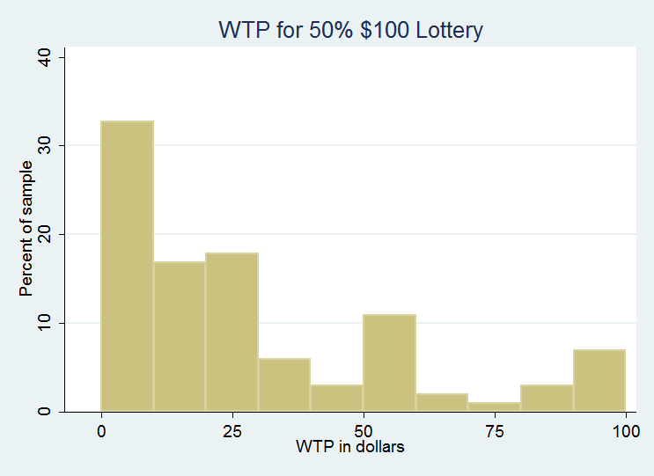
Control: Probability Weighting Function

Slide 9
The Main Exercise
Demographics
Gender, Age, Region, Ethnicity, Education, Field of study
Flip a coin 20 times
Guess each one and win some chocolate!
Or a “warm glow” if you took it online

Slide 10

I am a Liar!

Slide 11
The coin is weighted!
H H T H H T H H H H T H T H H H T H H H
75% bias towards heads
15 heads, 5 tails
Possible but not probable
BinCDF(0,5) = 2%
In-person: players rewarded with chocolate
Goal is to update probabilities

Slide 12
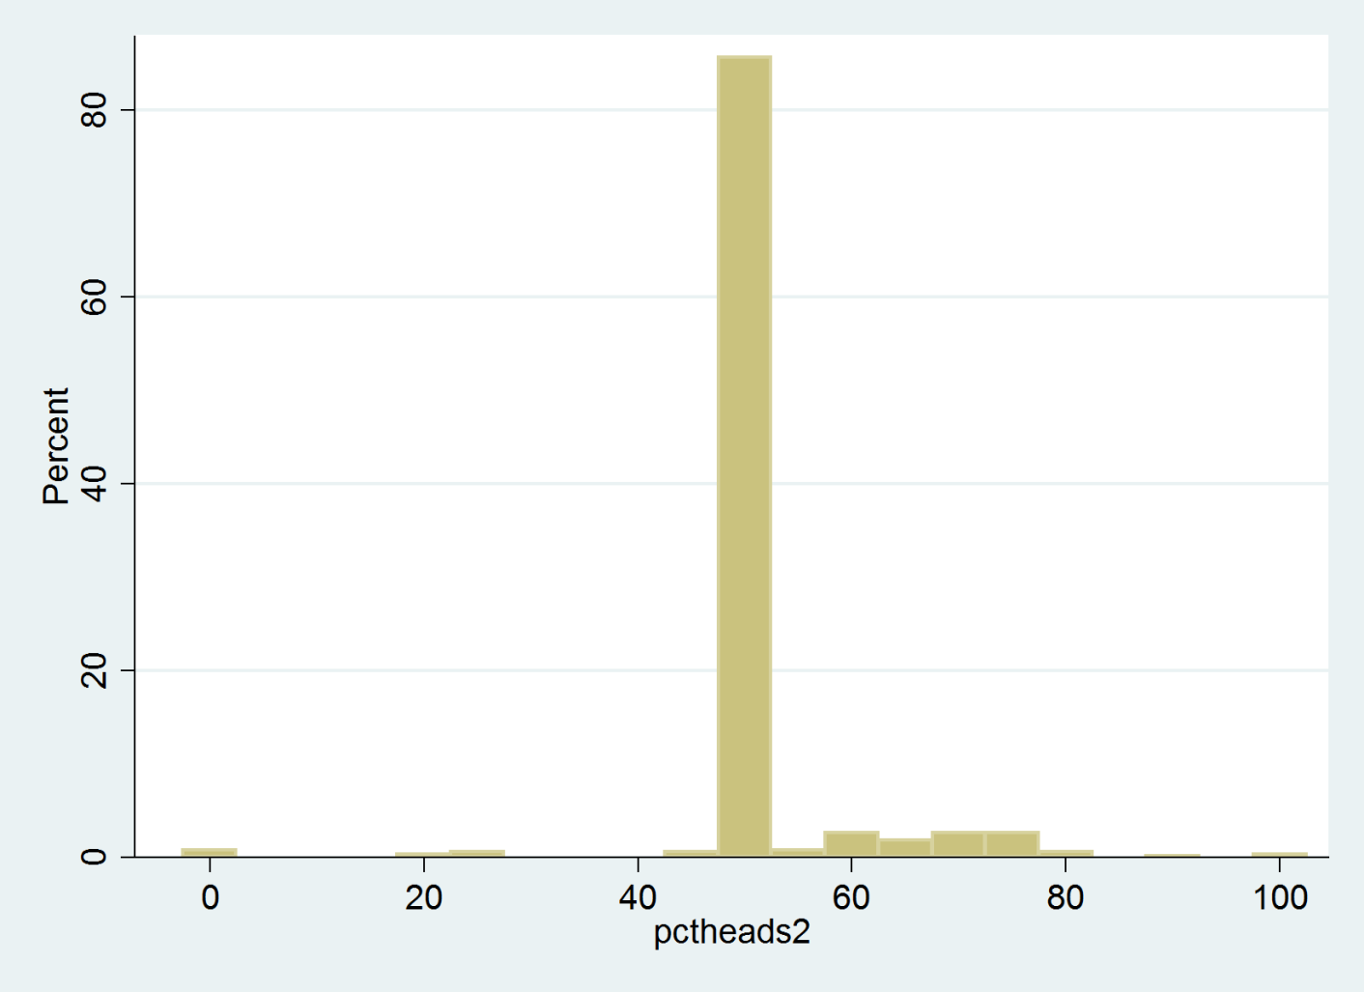
The First Sample: AKA Disaster

Slide 13
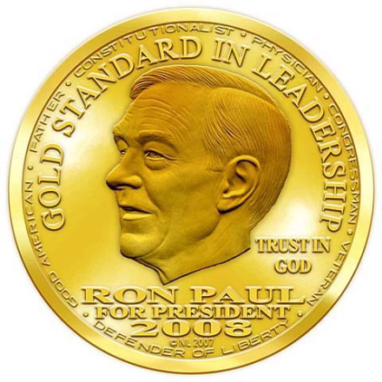
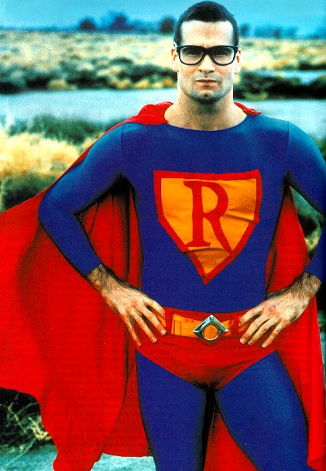
:( I’ll never lie to you again..
Now I have a coin from another planet.
It has unknown properties.
This includes probabilities!

Slide 14
Percent choosing heads

Slide 15
. reg wtpcall wtplottery ind
Source | SS df MS Number of obs = 101
-------------+------------------------------ F( 2, 98) = 79.13
Model | 58887.04 2 29443.52 Prob > F = 0.0000
Residual | 36466.9204 98 372.111432 R-squared = 0.6176
-------------+------------------------------ Adj R-squared = 0.6098
Total | 95353.9604 100 953.539604 Root MSE = 19.29
------------------------------------------------------------------------------
wtpcall | Coef. Std. Err. t P>|t| [95% Conf. Interval]
-------------+----------------------------------------------------------------
wtplottery | .8528098 .0684072 12.47 0.000 .717058 .9885617
ind | 2.915371 4.019406 0.73 0.470 -5.061008 10.89175
_cons | 4.098337 2.950212 1.39 0.168 -1.756262 9.952936
------------------------------------------------------------------------------

Slide 16
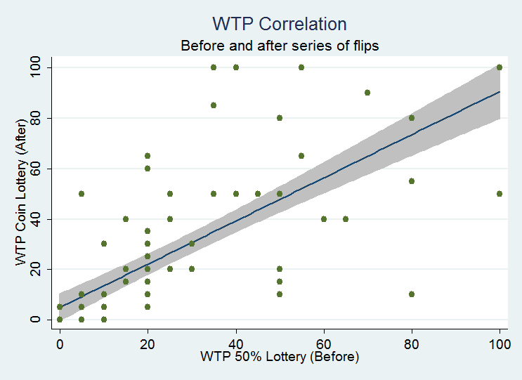

Slide 17
Eliciting Subjects’ Beliefs: Lottery Part Deux
I will give you $100 if you guess the next flip correctly.
If you call heads, how much are you willing to pay to play my game?

Slide 18
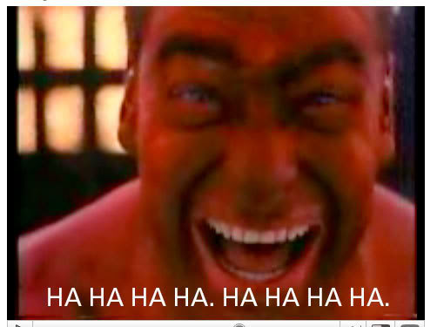
Ohohoho! Sucker! I am a liar! (And I’ll keep lyin’.)

Slide 19
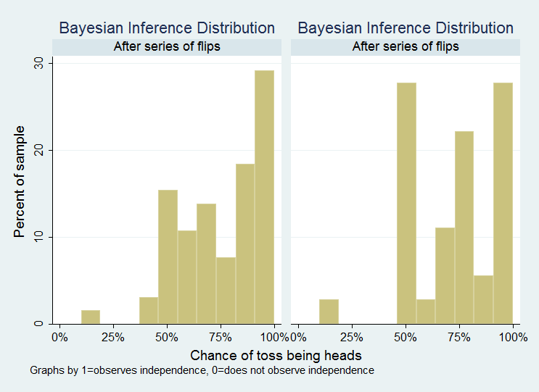
Distribution by Independence

Slide 20
Conclusions
Inconclusive actually!
Does elucidate avenues of further research
Changes to experiment?
Patterns
Different probability mechanism
More rewarding
More engaging

Slide 21
Questions? :)
Thanks.

